Slide 1
Diversity Analysis of the UMD Global Classroom Participants
Team IC23057: Matthew Chin, Ramith Wijesinghe Kidus Solomon, and Courtney Brandon
Notes:
UMD Office of International Affairs - Global Learning Initiatives
Team IC23057: Matthew Chin, Ramith Wijenshje, Kidus Solomon, and Courtney Brandon
2023

Slide 2

Background
After Covid-19, Global Classrooms courses and the student population participating in GC have increased significantly. With this in mind, the OIA seeks to understand the student diversity trends for the previous semesters of GC. This task is relevant to OIA in its efforts to…
1) Devise steps to provide “Global Learning for all” to every UMD student
2) Communicate and engage with faculty interested in participating in GC as well as institutional authorities who are interested in learning the development of this unique initiative.

Slide 3
Goal: Analyze Diversity Trends In UMD and Global Classroom Data
1. How is the student diversity of Global Classrooms compared to UMD College Park student diversity?
2. How does the student diversity (understood as race, ethnicity, gender, college, residency) vary by semester? By academic year?
3. Do these trends vary by student status (undergraduate/graduate)?
4. How does the number of courses vary by semester? By academic year?

Slide 4




Analytic Tools
Tableau (data visualizations)
Microsoft Excel (To manipulate GC data to fit our needs)
RStudio (data analysis)
Jupyter Notebook (data analysis)

Slide 5
Undergraduate Data

Slide 6
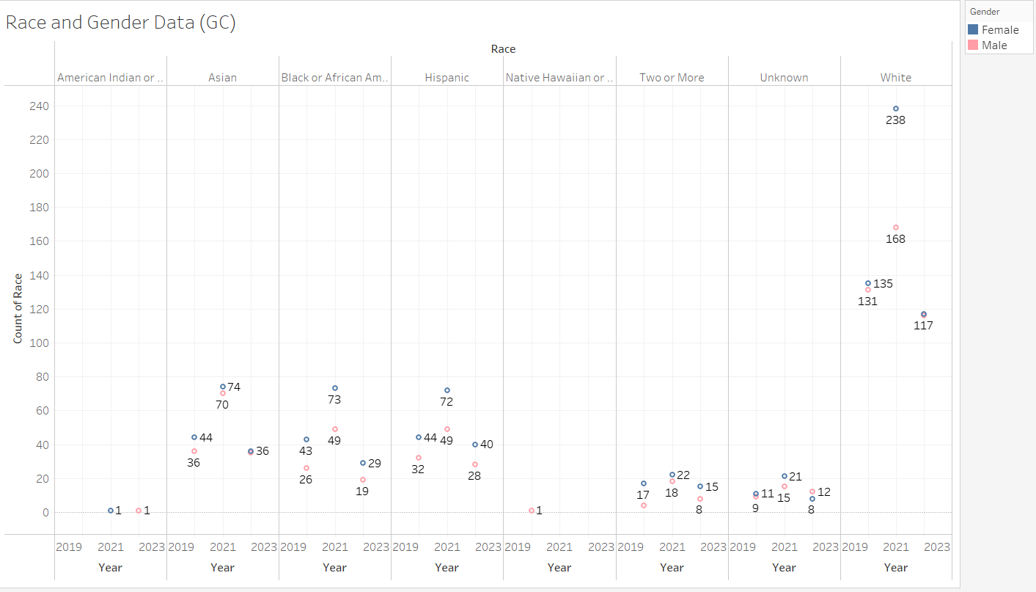
Findings (based on the overall data):
2021 was the peak for most years
An overall decrease in enrollment after 2021
The Caucasian racial group remains the highest enrolled racial group each year
Male enrollment is higher than female
We predict that because of COVID-19’s effect on education, GC enrollment increased to its peak (2021)
Notes:
Fall undergraduate race and gender data

Slide 7
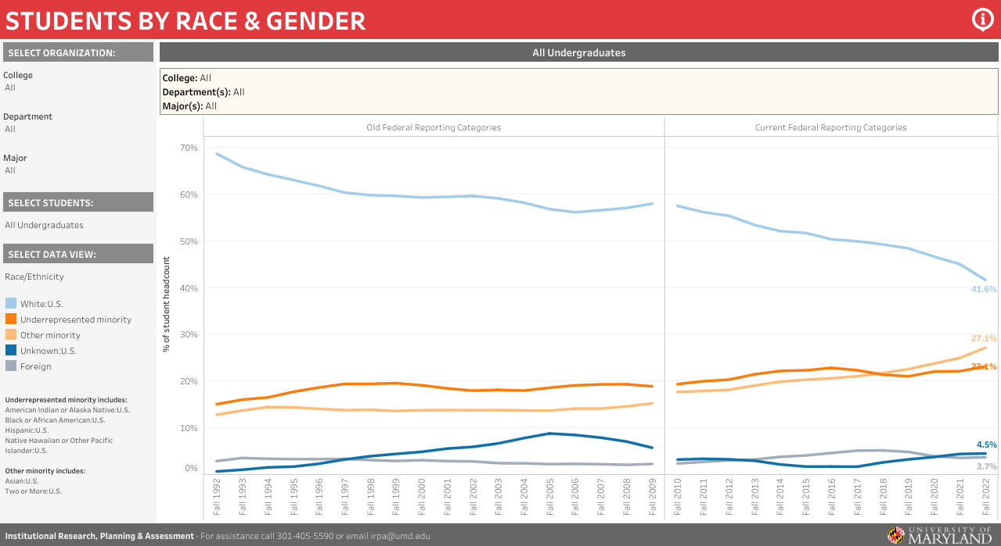
More of an overall increase (during Fall 2019-2022) for UMD enrollment
Notes:
https://reports.umd.edu/tableaupublic/1813
According to the data, after each year, the percentage of both underrepresented (22.4%) and other (27.1%) minority population rise, while the caucasian population (41.6%) decreases, although still representing majority of the data.
There also seems to be a slight increase in the unknown (4.5%) population and slight decrease in the foreign (3.7%) population.

Slide 8
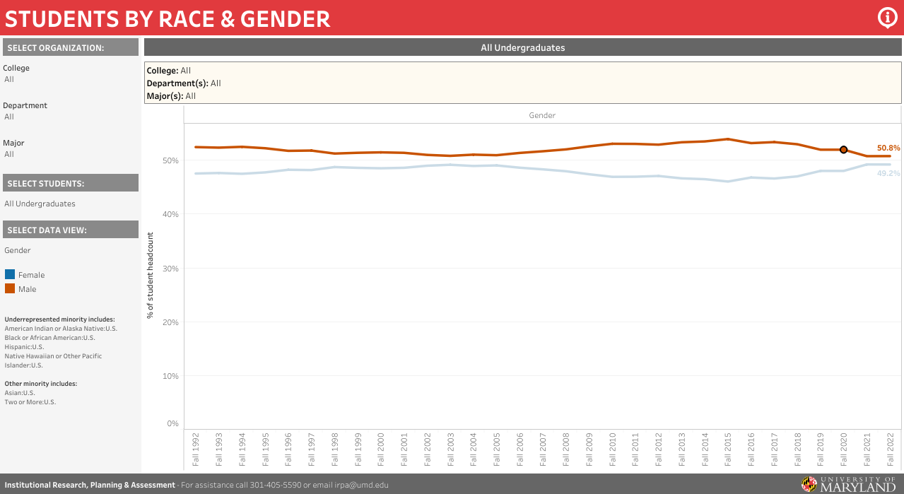
As the years go by, there seems to be a more equal proportion of both genders
Notes:
https://reports.umd.edu/tableaupublic/1813
According to the data, after each year, the male population (50.8%) decreases slightly while still representing a majority of the overall data. The female population (49.2%), however, increases slightly each year.
We can conclude that as the years go by, there seems to be almost an equal proportion of both genders in the overall data.

Slide 9
Diversity
(Race, Gender, Student Status, Ect.)

Slide 10
Gender (GC)
Typically higher Female Enrollment on average
Highest Female Enrollment was Spring and Summer 2021 (~70.44% female enrollment)
Fall 2020 Had Highest Female Population Size 348 total (52.66%)
Outlier Semester: Summer 2022 had higher male enrollment than Female (55.55%)

Slide 11
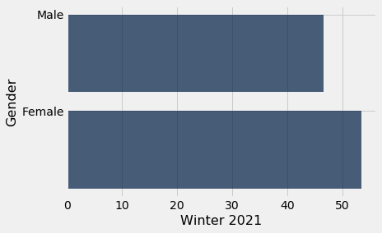
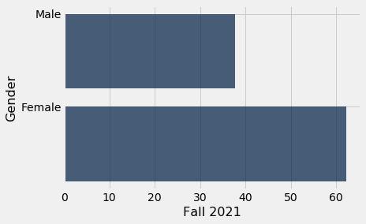
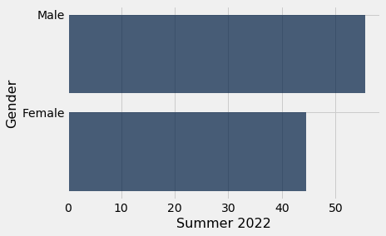
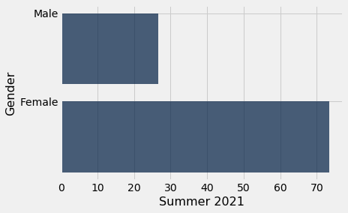
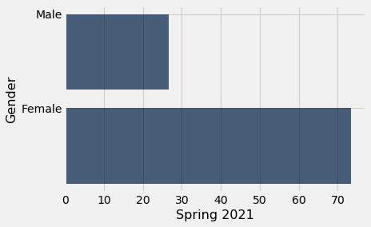
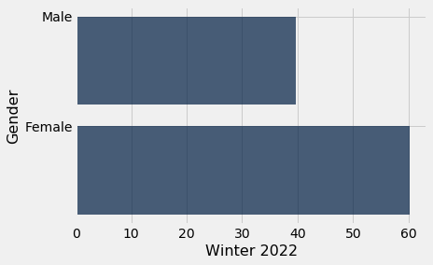
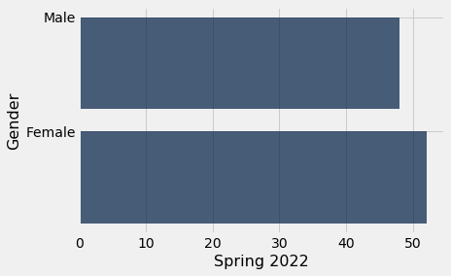
Gender (GC)

Slide 12
Race/Diversity (GC)
African American enrollment takes severe dips every winter
Asian Enrollment takes severe dips every winter and summer
Highest average racial population enrolled was White followed by Hispanic
Enrollment peaked across the board early 2021

Slide 13
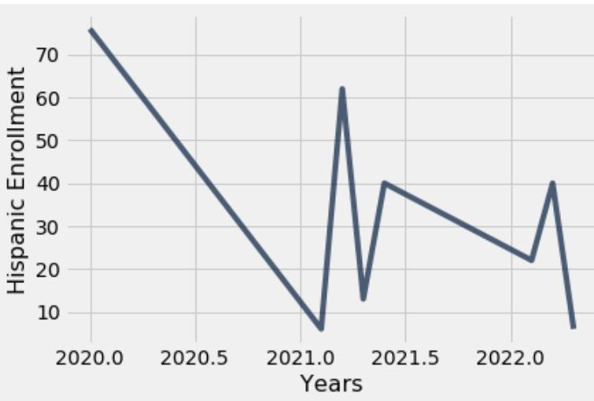
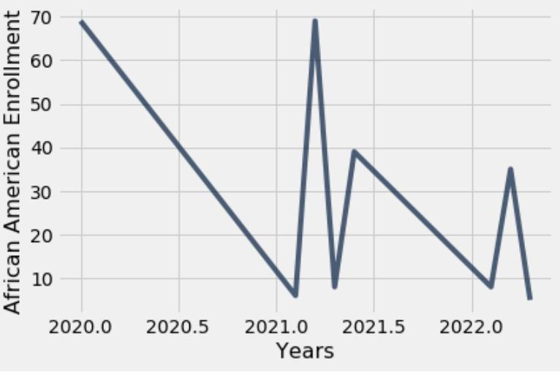
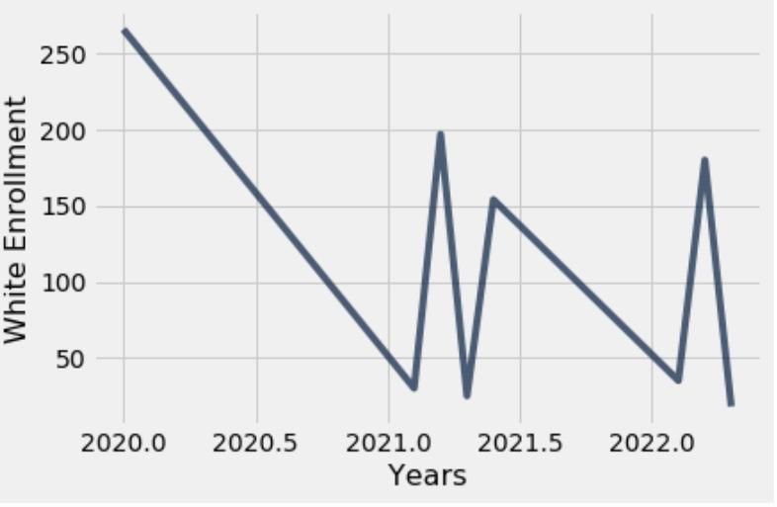
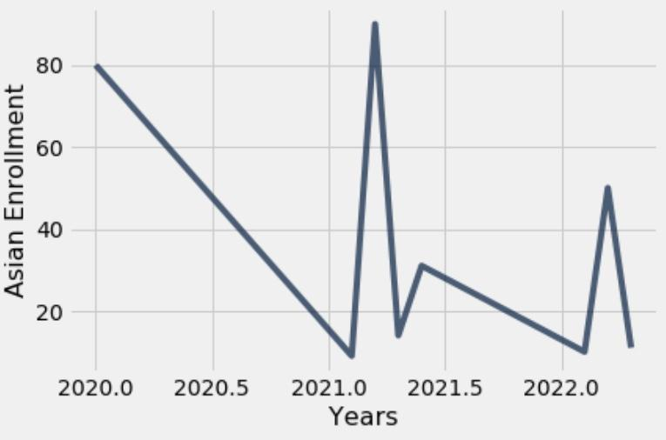
Race/Diversity (GC)

Slide 14
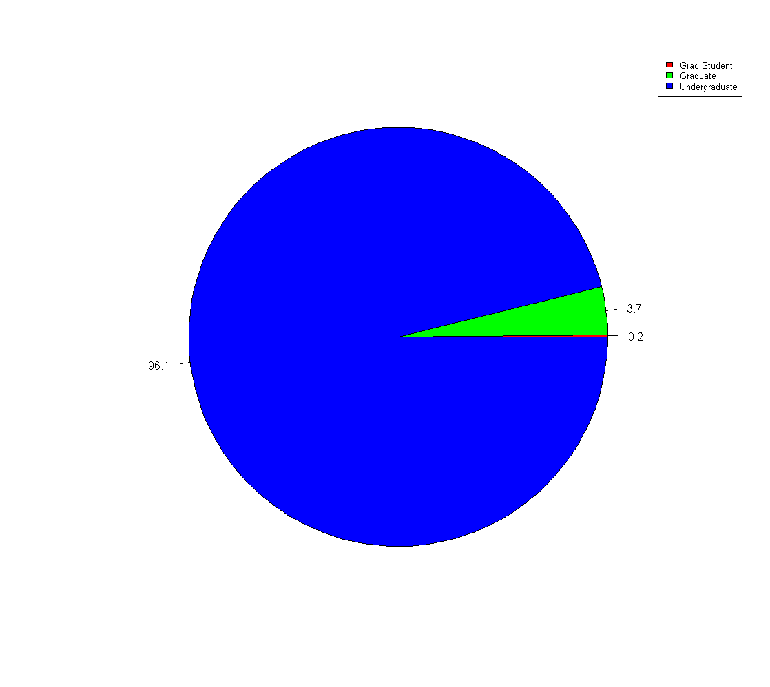
Vary by Student Status
The Amount of Undergraduate students have always been high.
After 2022 Summer Grad Student count starts to rise bit by bit.
Does not seem to have a huge impact as most students are Undergraduate.

Slide 15
Courses (GC)

Slide 16
Courses Taken Over the Years
Over the years the amount of courses taken have decreased with Fall 2020 having the most while Summer 2022 the least
ENGL391 is the most picked course overall.
It is clear that Covid has impacted the amount of students studying.

Slide 17
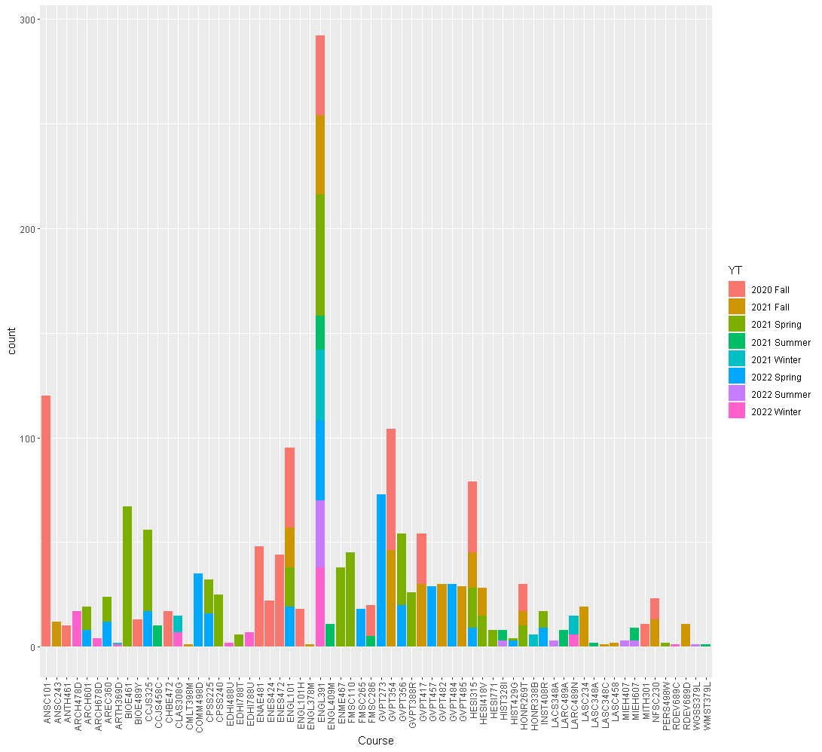
Courses over All Terms

Slide 18
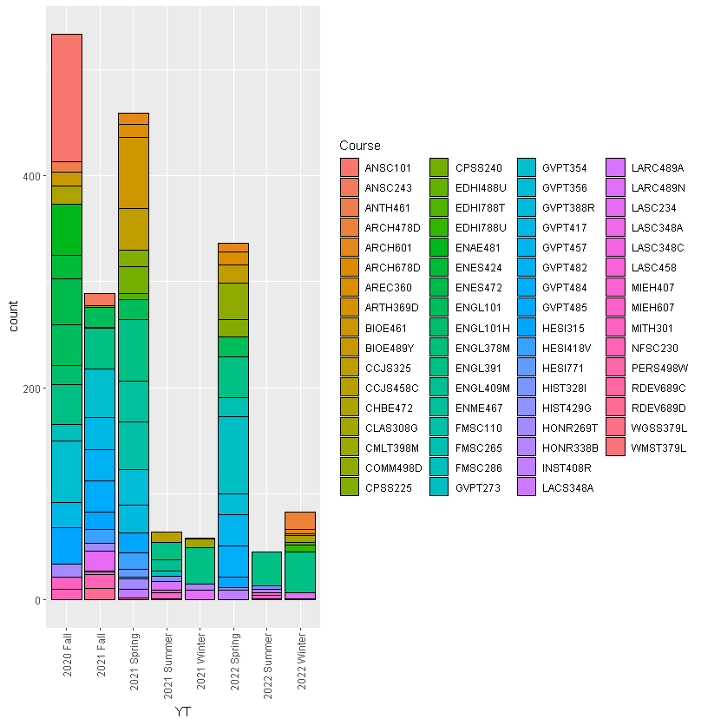
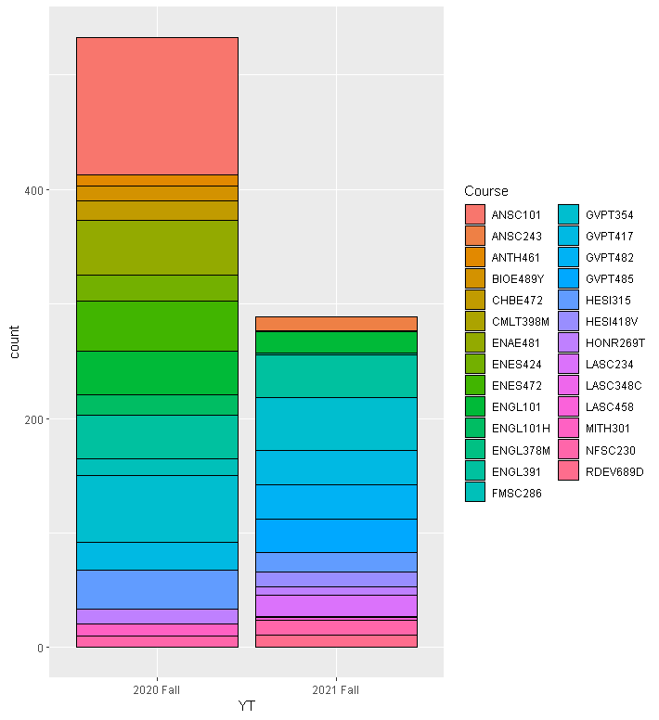
Courses in each Academic year

Slide 19
Conclusions & Suggestions
1. How is the student diversity of Global Classrooms compared to UMD College Park student diversity? Overall, the student diversity (race and gender) is commonly similar between the two. It is only the enrollment population that is different.
2. How does the student diversity (understood as race, ethnicity, gender, college, residency) vary by semester? By academic year? Largely Female population with huge gaps in Summer 21 to Winter 22 with almost 60-70% female enrollment. Also largely white and hispanic population.
3. Do these trends vary by student status (undergraduate/graduate)? There is a large undergraduate population from the years from Fall 2020- Spring 2022. There has been a small increase over the years for grad students. Although, that is the case it is still an insignificant amount to the undergraduate population.
4. How does the number of courses vary by semester? By academic year? ENGL391 is by far the most popular course taken across multiple semesters, Most courses taken in a single term was the 2020 Fall term, which had ANSC101 dominating.

Slide 20
Additional Questions
How Useful would this data be in the real world?
What could help gather more reliable data in the future?

Slide 21

References
Welcome to Global Classrooms. Global. (1970, March 2). Retrieved March 1, 2023, from https://globalmaryland.umd.edu/content/welcome-global-classrooms
reports.umd.edu. Reports.umd.edu. (n.d.). Retrieved March 1, 2023, from https://reports.umd.edu/.
Notes:
Team Abstract:
https://docs.google.com/document/d/1F_LKwNGGRFzxKjXhpZ4JUFxvluoR8x0rwgRnV8OjB4E/edit?usp=sharing

Slide 22
Questions?
Notes:
Thank you! :)
https://docs.google.com/document/d/1iS0Ygn9oW_j6K-Nm061bYURf_7u6oQBMc-MKpQUyoEI/edit?usp=sharing

